Slide 1
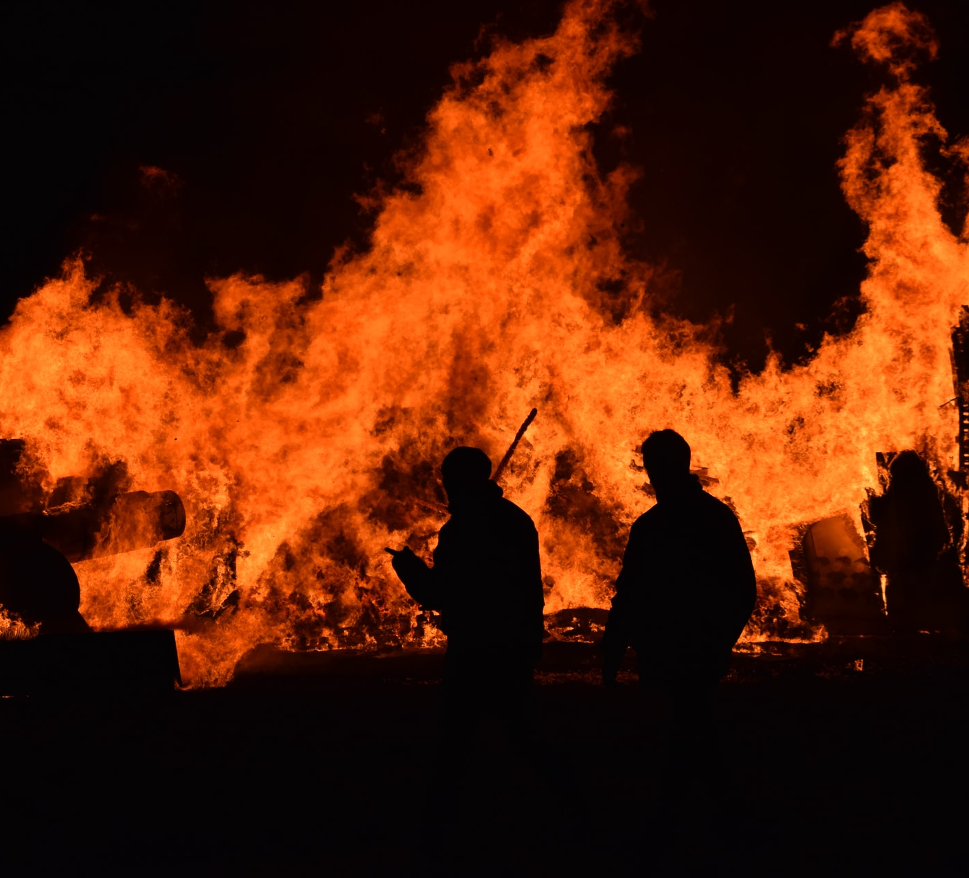
California Wildfire Dashboard Project
Team 7:
Margaret Thorpe
Michael regpala
Toni Trieu

Slide 2

Key Questions
Have California wildfires becomes more frequent?
Have California wildfires become larger?
Have California wildfires become more destructive?
Notes:
For our project we wanted to explore whether California wildfires have become larger, more frequent and more destructive……and, if we had time, to investigate whether drought might be a contributing factor.

Slide 3
The Data
Wildfire Incident dataset
CSV dataset on Kaggle covering 2013-2019 that was originally scraped from https://www.fire.ca.gov/incidents/
https://www.kaggle.com/ananthu017/california-wildfire-incidents-20132020
Some Data Quality & Availability issues
NIFC (National Interagency Fire Center) completely changed how wildfire incident data is managed & hosted in 2020, so we didn’t have time to get 2020 data.
Because of the cutoff point for this data, some of the 2019 incidents were not closed out and finalized when fully extinguished (only finalized incidents are included in this dataset), so the 2019 data is incomplete.
A handful of incidents with missing or invalid coordinates – so while they are included in stats & queries, they do not appear on the map.
A handful of large fires that spanned multiple counties had duplicate records in the dataset that we had to remove.
Drought dataset
CSV dataset covering percentages of California in different levels of drought status from 2000-2021
https://droughtmonitor.unl.edu/Data/DataTables.aspx
Historical California Wildfire data is not easily accessible, but we found a pretty good dataset covering 2013-2019.
Notes:
To do this, we found a couple of good datasets:
- A CSV file on Kaggle covering wildfire incidents from 2013-2019 that were originally scraped from www.fire.ca.gov/incidents/ website.
There were a few issues with the dataset (aren’t there always?):
Missing 2020 altogether, and 2019 was likely incomplete (the dataset contains only fires that were in a finalized status)
Some duplicate records for large fires, which we removed.
Some incorrect coordinates
The US Drought Monitor had a great dataset in CSV format, breaking out the % of California that was in different levels of drought from 2000-2021.
So, with this data, we set out to build a dashboard to explore our questions……………

Slide 4







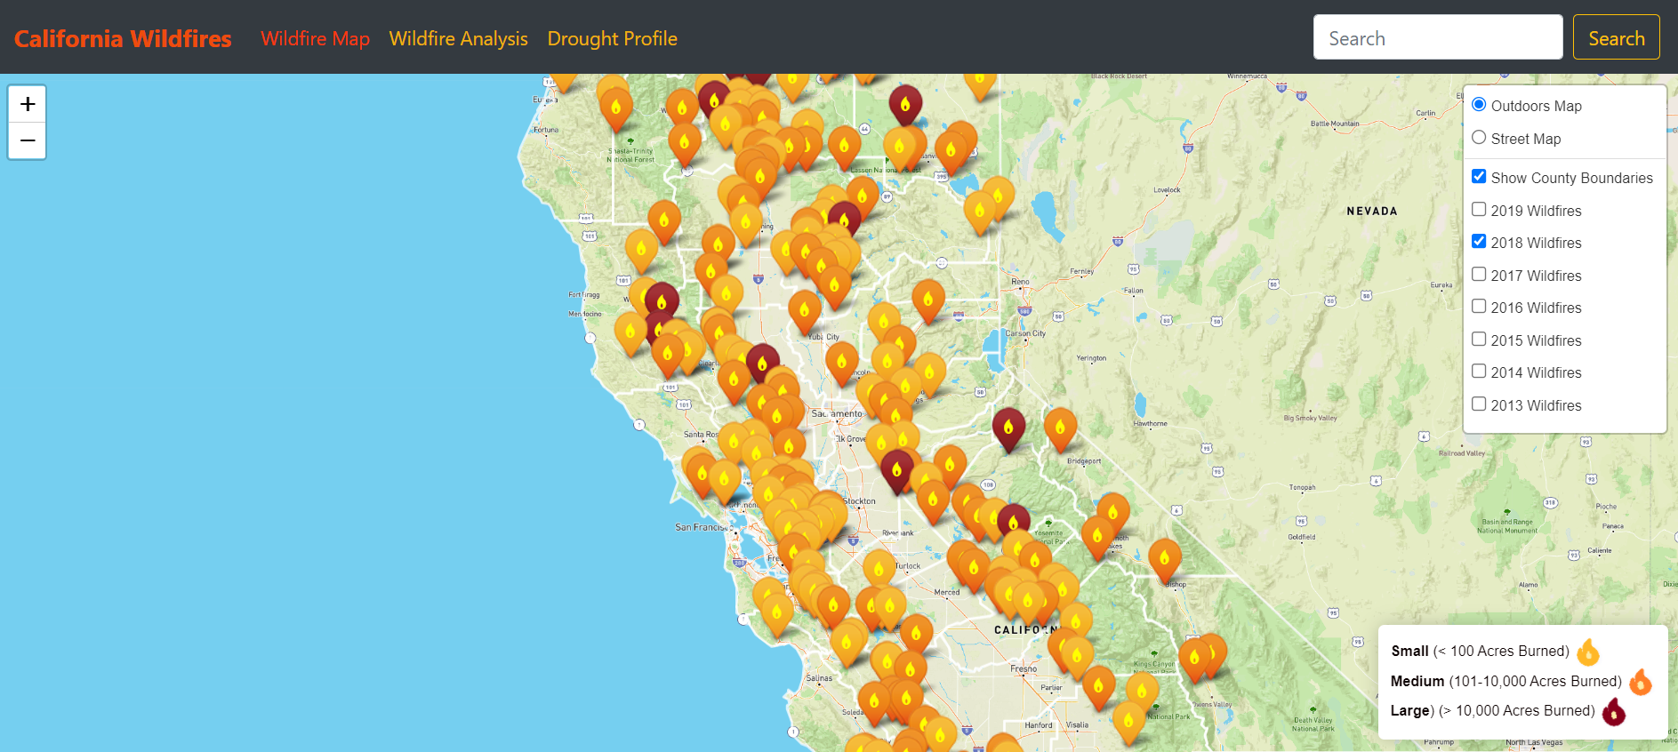

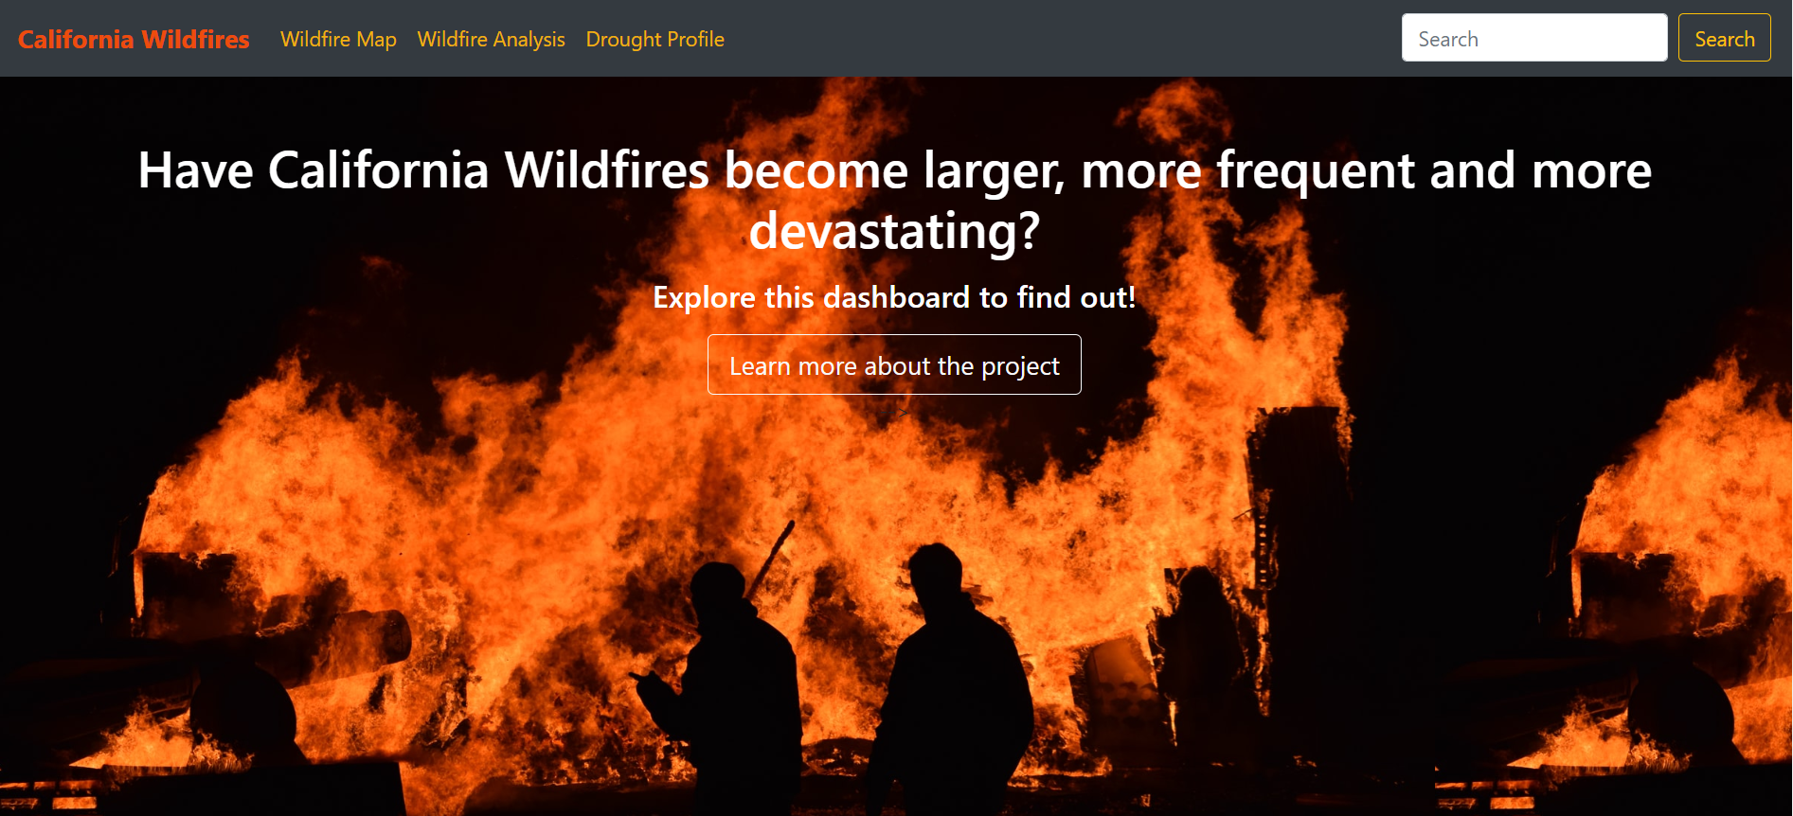




Wildfire Incident Data Engineering Solution Architecture
NodeJS API serving up query endpoints
All ETL done on PostgreSQL
Conversion using csv2geojson library
Notes:
For the data engineering of the Wildfire Incident data, we took two approaches:
1- For mapping purposes, we converted the CSV data to GeoJSON format, then used Leaflet to create and display our Wildfire map on the front-end using Bootstrap, Javascript, HTML and CSS.
2- For querying and charting purposes, we loaded the data onto a PostgreSQL database server in the cloud and did all of the ETL using SQL.
We used NODEjs to serve up query results to several API endpoints, and then used Plotly to create and display several charts/graphs on the front end.
And here’s what out dashboard looks like……..

Slide 5
Quick Demo
California Wildfire Dashboard

Slide 6
Summary of Findings
California wildfires have become more frequent over this time period.
California wildfires have not necessarily become larger during this period.
California wildfires have become more destructive Over this time period.
Notes:
And to summarize our findings, based on our analysis of this data, we concluded that:
CA wildfires have definitely become more frequent and more destructive during this time period.
But we were unable to conclude, based on this data, that they have become bigger.

Slide 7
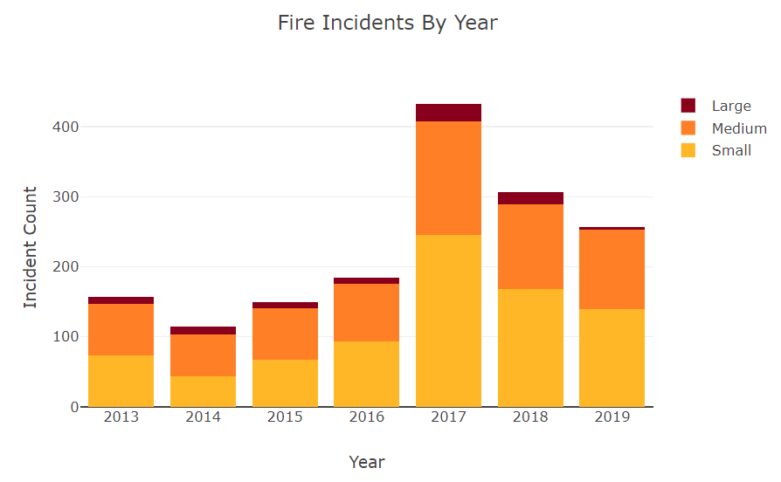
California wildfires have become more frequent over this time period.
Notes:
As we saw on the dashboard, the number of wildfires has increased significantly over this time period…..

Slide 8
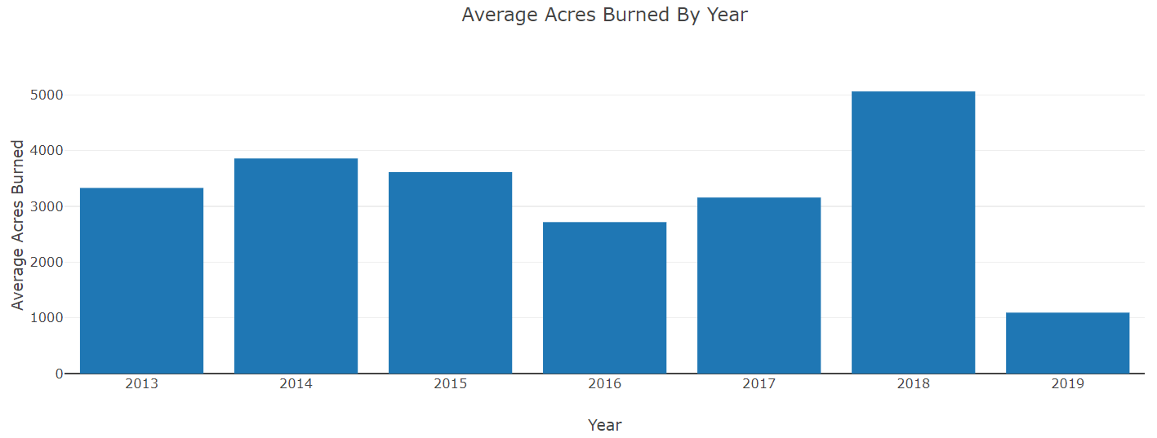
it is not clear that California wildfires have become larger, on average during this time period.
Notes:
But based on the data that we have, it is not clear that the average size of wildfires is increasing.
We would need complete 2019 and 2020 data to better assess whether this is the case.

Slide 9
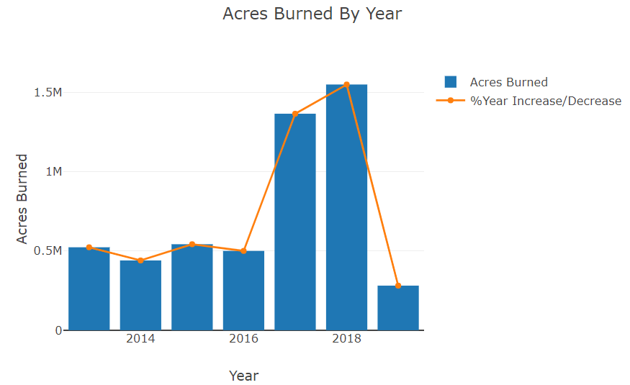
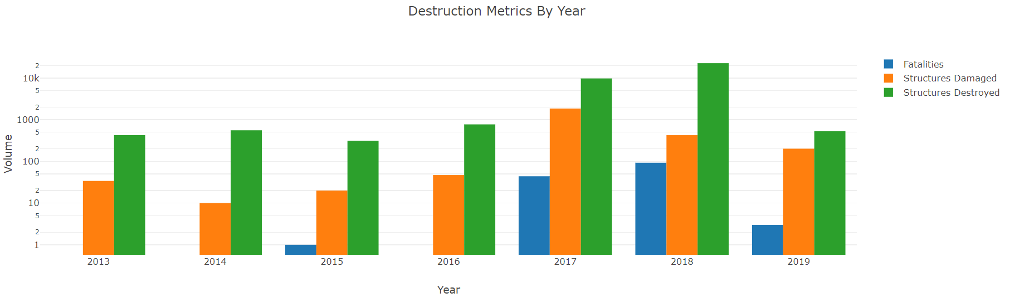
California wildfires have become more destructive over this time period.
Notes:
Without a question, we can conclude that wildfires have become more destructive over this period…..as indicated by the increase in acres burned, as well as fatalities and structures damaged and destroyed that we saw on the dashboard.

Slide 10
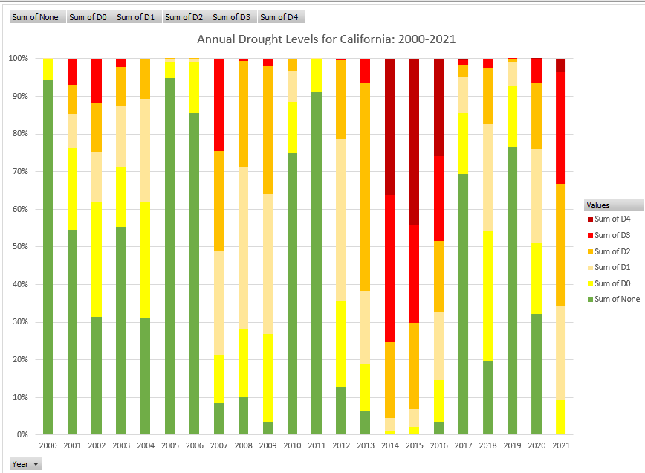

Contributing Factors
Could drought be a contributing factor?
Tree rings show that 2000-2018 is the driest 19-year period in centuries
Just looking at the last 20 years, there appears to be an increase in the percentage of California experiencing drought conditions. In 2014, 2015 and 2016 all or most of the state was in extreme drought.
Could drought be a leading indicator?
It certainly appears plausible,as 2017 and 2018 were such extreme wildfire years, but this would require additional data and analysis.
Drought
Notes:
We were curious if drought may have contributed to the increase in the number of wildfires and their destructiveness.
Looking at California’s drought profile from 2000 to 2021, we can see that the level of drought definitely increased over this period with 2014, 2015 and 2016 being extreme.
Given that wildfires ticked up significantly in 2017 and 2018 it is plausible that drought could be a leading indicator, but this would need to be researched further.

